Slide 1
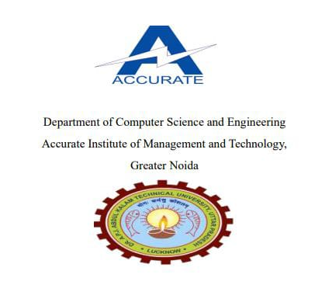
MINOR PROJECT
Resume Builder Web Application
By
Under the Guidance
Of
Mrs. Pooja Verma
(Asst. Professor, CSE Dept.)
Priti Yadav
Roll No -2302250100175
B.Tech (CSE)
Nikita Shrivastava
Roll No -2302250100160
B.Tech (CSE)

Slide 2
Presentation Outline
Introduction to Project
Technology Used
Existing Gaps & Project Features
Objectives
Scope/Relevance
Project snapshot
Output
Conclusion & Future Aspects

Slide 3
Introduction
Creating a resume is a bit tedious task for any working professional from any industry. One has to keep it short, simple, with the latest work experience and constantly update it over a while. It is an application that simplifies the task of creating a resume for individuals. The system is flexible to be used and reduces the need of thinking and designing an appropriate resume according to qualifications. The system is developed to provide an easy means for creating a professional looking resume. Individuals just have to fill up a form that specifies questions from all required fields such as personal questions, educational, qualities, interest, skills and so on. The answers provided by the users are stored and the system automatically generates a well - structured resume. Users have option to create resume in any format and file.

Slide 4
Technology Used
Html
CSS
JavaScript

Slide 5
Project Features
Flexible text editor
Easy-to-use interface
Highly customizable
Unlimited printing and downloads
PDF resumes
Easy to share
Unlimited PDF downloads

Slide 6
Analysis and feature
It is an application that simplifies the task of creating a resume for individuals. The system is flexible to be used and reduces the need of thinking and designing an appropriate resume according to qualifications. The system is developed to provide an easy means for creating a professional looking resume. Individuals just have to fill up a form that specifies questions from all required fields such as personal questions, educational, qualities, interest, skills and so on. The answers provided by the users are stored and the system automatically generates a well structured resume. Users have option to create resume in any format and file.

Slide 7
Objectives
h1. **Objective**:
- Manage details of resumes, jobs, individuals, skills, and qualifications.
2. **Functionality**:
- Handles all information about resumes, job seekers, and qualifications.
- Designed primarily for administrative use, with restricted access for administrators.
3. **Application Purpose**:
- Simplifies the process of creating resumes.
- Enables professionals to generate concise, updated, and formatted resumes effortlessly.
4. **Technology Used**:
- Built using ReactJS and NodeJS.
5. **Features**:
- Auto-generates professionally formatted resumes based on user-inputted information.
- Reduces manual effort in thinking and designing resumes.
- Provides flexibility to create resumes in various formats.
6. **Process**:
- Users fill out a form with personal, educational, and professional details, along with skills and interests.
- Data is stored, and the system generates a structured and visually appealing resume.
7. **Advantages**:
- Eases the tedious task of resume creation for working professionals.
- Keeps resumes concise and updated with the latest work experience.
- Offers satisfaction in creating resumes independently.
- Delivers a professional layout with minimal effort.

Slide 8
Scope
Resumes can also be classified according to different branches and for specific companies.
For example:-
If someone has more practical experience and less CGPA/Percentage and resume should emphasize on project of the person more.

Slide 9
<!DOCTYPE html>
<html lang="en">
<head>
<meta charset="UTF-8" />
<meta http-equiv="X-UA-Compatible" content="IE=edge" />
<meta name="viewport" content="width=device-width, initial-scale=1.0" />
<title>Resume Generator</title>
<link href="https://cdn.jsdelivr.net/npm/bootstrap@5.0.0-beta2/dist/css/bootstrap.min.css" rel="stylesheet"
integrity="sha384-BmbxuPwQa2lc/FVzBcNJ7UAyJxM6wuqIj61tLrc4wSX0szH/Ev+nYRRuWlolflfl" crossorigin="anonymous" />
<link rel="stylesheet" href="https://cdnjs.cloudflare.com/ajax/libs/font-awesome/4.7.0/css/font-awesome.css"
integrity="sha512-5A8nwdMOWrSz20fDsjczgUidUBR8liPYU+WymTZP1lmY9G6Oc7HlZv156XqnsgNUzTyMefFTcsFH/tnJE/+xBg=="
crossorigin="anonymous" referrerpolicy="no-referrer" />
<link rel="stylesheet" href="style.css" />
</head>
<body>
<!-- DashBord -->
<div class="card mx-5 mt-3" id="cv-form">
<div class="container">
<div class="card-header">
<h1 class="text-center my-2">Resume Builder</h1>
</div>
<div class="card-body">
<div class="contain">
<div class="row">
<div class="col-md-6">
<!-- first col -->
<h3>Personal Information</h3>
<div class="form-group">
<label for="nameField">Your Name</label>
<input type="text" id="nameField" placeholder="Enter here" maxlength="20" class="form-control" />
</div>
<div class="form-group mt-2">
<label for="jobFiled">Your Job title </label>
<input type="text" id="jobFiled" placeholder="Enter here" maxlength="20" class="form-control" />
</div>
<div class="form-group mt-2">
<label for="contactField">Your Contact</label>
<input type="text" id="contactField" placeholder="Enter here" maxlength="10" class="form-control" />
</div>
<div class="form-group mt-2">
<label for="gmailFiled">Your gmail</label>
<input id="gmailFiled" placeholder="Enter here" maxlength="50" class="form-control"></input>
</div>
<div class="form-group mt-3">
<label for="imgField">Select your photo</label>
<input id="imgField" type="file" class="form-control" />
</div>
<p class="text-secondary my-3">Important Links</p>
<div class="form-group mt-2" id="li">
<div class="form-group mt-2">
<label for="fbField">Address </label>
<input type="text" id="fbField" placeholder="Enter here" maxlength="200" class="form-control" />
</div>
<div class="form-group mt-2">
<label for="linkedField">Birth day</label>
<input type="date" id="linkedField" placeholder="Enter here" class="form-control" />
</div>
<div class="form-group mt-5" id="ed">
<label for="">Education</label>
<textarea placeholder="Enter here" class="form-control edField" rows="3"></textarea>

Slide 10
<div class="container text-center mt-2" id="aqAddButton">
<button onclick="addNewEdField()" class="btn btn-primary btn-sm">
Add
</button>
</div>
</div>
<div class="form-group mt-2" id="la">
<label for="">languages</label>
<input placeholder="Enter here" class="form-control laField"></input>
<div class="container text-center mt-2" id="laAddButton">
<button onclick="addNewLanField()" class="btn btn-primary btn-sm">
Add
</button>
</div>
</div>
</div>
</div>
<div class="col-md-6">
<!-- second col -->
<h3>Professional Information</h3>
<div class="form-group mt-2">
<label for="">Objective</label>
<textarea id="objectiveField" rows="5" placeholder="Enter here" maxlength="500" class="form-control"></textarea>
</div>
<div class="form-group mt-2" id="we">
<label for="">Work Experience</label>
<!-- <div class="form-group mt-2" id="ti">
<label for="">Title</label>
<input placeholder="Enter here" class="form-control tiField"></input>
</div> -->
<div class="form-group mt-2">
<label for=""> Your Experience </label>
<textarea placeholder="Enter Experience" class="form-control weField" maxlength="500" rows="3"></textarea>
</div>
<!-- new textarea -->
<div class="container text-center mt-2" id="weAddButton">
<button onclick="addNewWEField()" class="btn btn-primary btn-sm">
Add
</button>
</div>
</div>
<div class="form-group mt-2" id="sk">
<label for="">PROFESSINAL SKILLS</label>
<input placeholder="Enter here" class="form-control skField" rows="3"></input>
<div class="container text-center mt-2" id="skAddButton">
<button onclick="addNewAQField()" class="btn btn-primary btn-sm">
Add
</button>
</div>
</div>
<!--<div class="form-group mt-2" id="cr">
<label for="">CERTIFICATIONS</label>
<input placeholder="Enter here" class="form-control skField" rows="3"></input>

Slide 11
<div class="container text-center mt-2" id="crAddButton">
<button onclick="addNewAQFieldcr()" class="btn btn-primary btn-sm">
Add
</button>
</div>
</div>-->
</div>
</div>
</div>
</div>
<div class="container text-center">
<button onclick="generateCV()" class="btn btn-primary btn-lg">
Generate cv
</button>
</div>
</div>
</div>
<!-- end Dashbord -->
<!-- start cv -->
<div class="cv" id="cv-template">
<div class="container">
<div class="left">
<div class="text">
<div class="pic">
<img id="imgTemplate" src="" alt="" class="img-fluid myimg" />
</div>
<h2 id="nName"> </h2>
<span id="jJob" style="text-align: center;"> </span>
</div>
<div class="info">
<h3 class="title">contact info</h3>
<ul>
<li> <span class="icon"><i class="fa fa-phone" aria-hidden="true"></i></span>
<span id="cContact">Phone</p>
</li>
<li>
<span class=" icon"><i class="fa fa-envelope" aria-hidden="true"></i></span>
<span id="gGmail">Gmail</span>
</li>
<li>
<span class="icon"><i class="fa fa-map-marker" aria-hidden="true"></i></span>
<span id="fFacebook" href="">Address</span>
</li>
<li><span class="icon"><i class="fa fa-calendar" aria-hidden="true"></i></span>
<span id="lLinkedin" href="">Birth Day </span>
</li>
</ul>
</div>
<div class="edu">
<h3 class="title">Education</h3>
<ul id="edu">
</ul>
</div>
<div class="lang">
<h3 class="title">languages</h3>
<ul id="lan">
</ul>
</div>
</div>

Slide 12
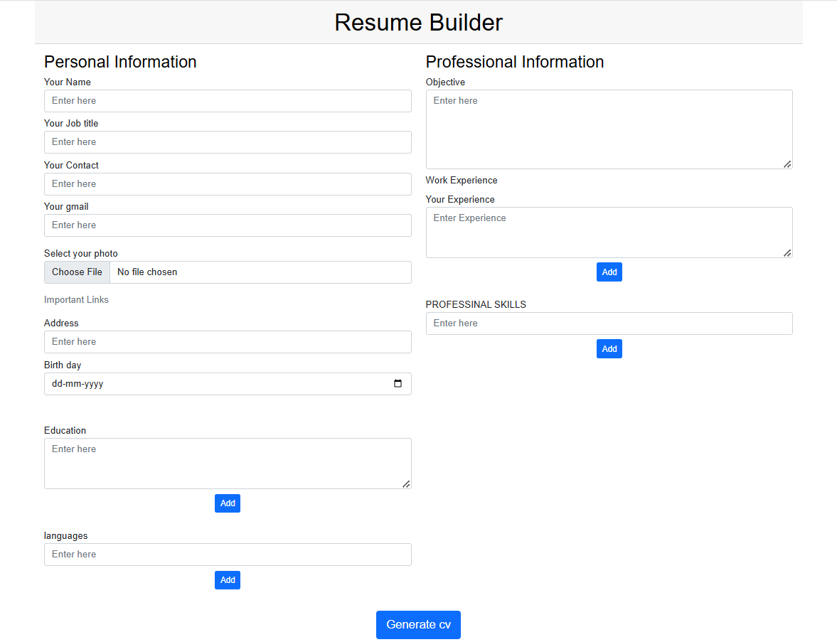
Project Snapshot

Slide 13
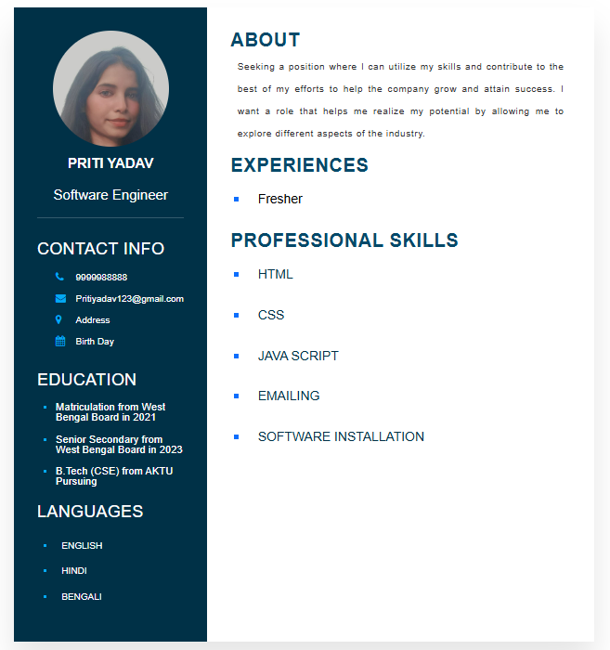
Output:

Slide 14
Advantages
Provides instant resume to individuals.
There are choices available for resume format for users as per their qualification and requirements.
Reduces tedious work in thinking and creating resume and is
Convenient for users.
Provides quick access and is affordable.
The system saves time and reduces human efforts.

Slide 15
Methodology
Requirements Analysis : Identitfy user needs and desired features like t emplates ,formatting,and export options .
Planing and Design : create a user-friendly interface and decide on the application type web mobile or desktop.
Technology selection : choose tools and frameworks for fronted backened database and PDF generation.
Development: build features like templates selection realtime preview and export functoionally.
Testing: Performance unit integration and user acceptance testing to ensure reliability and compatibility.
Development : host the application on a suitable platform and setup version control.
Maintenance: continuously improved based on user feedback and apply regular updates.
Documentation : create user manuals and technical guiidelines for reference.

Slide 16
Conclusion
The online resume builder is one of the most fantastic system for the people who are either
recently graduated students in their domain or if they don’t have enough idea about the
Resume or don’t have enough time to create the resume of good design and patterns, then
This platform is very productive place for them. Resume builder will analysis and give the
Required output of top trending technologies with proper proof of data, graphics and static.
Thus students can analysis the material and course opt for which will be more useful to them
In their placement and future.
It will be clear path and guide which will make their decision much more easy and affective.
Their will be a less chance regrating and wasting their time on different courses which are
not worth.

Slide 17
References
https://www.w3schools.com/tags/att_input_maxlength.asp
https://www.geeksforgeeks.org/free-online-resume-builder-by-geeksforgeeks-create-your-resume-now/?ref=header_ind
https://www.sublimetext.com/download_thanks?target=win-x64

Slide 18
THANK YOU

